Slide 1

Sigurnost računala i podataka
Mario Čagalj
Sveučilište u Splitu
18.10.2011.

Slide 2
Cryptographic Tools
Computer Security: Principles and Practice
by William Stallings and Lawrie Brown
Produced by Mario Čagalj

Slide 3
Introduction
Cryptographic algorithms are an important element in implementing security services (e.g., CIA)
In this lecture we review various types of cryptographic alogrithms (including their applicability)
  Symmetric encryption
  Public-key (asymmetric) encryption
  Digital signatures and key management
  Cryptographic hash functions

Slide 4
Symetric Encryption

Slide 5
Symetric Encryption: Introduction
The universal technique for providing confidentiality for both transmitted (communication) and stored data (DBs, files)
Five main ingredients
  Plaintext (P)
  Encryption algorithm (E[.])
  Secret key (K)
  Ciphertext (C)
  Decryption algorithm (D[.])
Secret key
K
Secret key
K
Plaintext
input
P
Plaintext
output
P=D[K,C]
Encryption algorithm
Ciphertext
C=E[K,P]
Decryption algorithm

Slide 6
Symetric Encryption: Main Elements
Plaintext (P)
  Original message or data to be encrypted
Encryption algorithm (E[.])
  Performs various transformations (substitutions) on the input plaintext
Secret key (K)
  Secret key is also input to the encryption algorithm
  Transformations on plaintext performed by the algorithm depend on the key
Ciphertext (C)
  Scrambled message produced by the encryption message (depends on the plaintext and the secret key
Decryption algorithm (D[.])
  Takes the ciphertext and the secret key and produces the original plaintext
Secret key
K
Secret key
K
Plaintext
input
P
Plaintext
output
P=D[K,C]
Encryption algorithm
Ciphertext
C=E[K,P]
Decryption algorithm

Slide 7
Symmetric Encryption: Secure Use
Two requirements for secure use
  We need a strong encryption algorithm (e.g., an attacker who knows E[.] and C is unable to decipher C or find the key K)
  Sender and receiver must obtain copies of the secret key in a secure fashion and must keep the key secure
Symmetric encryption example (DES encryption algorithm)
  P = Bob’s salary is $25000--Tom’s salary is $15000.
  K = 10 20 30 40 50 60 70 80
  C = DES[K,P] = 8E 04 0F 1D 1C 02 21 CE A4 73 8A 2C B3 E8 49 B7 0E 4D 37 EF E6 F0 7B FE 8A 51 32 5A 14 EE 5D 36 C5 81 EF A6 17 C8 F8 77 6C D4 29 BC D5 0B B2 04

Slide 8
Attacking Symmetric Encryption
Two general approaches: cryptanalysis and brute-force attack
Cryptanalysis
  Exploit the nature of the encryption algorithm and the general characteristics of the plaintex-ciphertext pairs
  Attempts to learn a specific plaintext or the secret key
  Once the key is compromised, all the future and past messages encrypted by this key are compromised
Brute-force attack (straightforward and easy one)
  Obtain a single (plaintext, ciphertext) pair
  Try out every possible candidate key K’ and check if P == D[K’,C]
  On average, half of all possible keys must be tried. Why?

Slide 9
Brute-Force Attack
Candidate keys
Bins and urn model
Average time to break (computational security)
Secret key
Secret key space
Key Size (bits) | Key Space | Time Required at 1 Decryption/μs | Time Required at 10⁶ Decryption/μs
32 | 2³² = 4.3 x 10⁹ | 2³¹ μs = 35.8 min | 2.15 miliseconds
56 | 2⁵⁶ =7.2 x 10¹⁶ | 2⁵⁵ μs = 1142 years | 10 hours
128 | 2¹²⁸ =3.4 x 10³⁸ | 2¹²⁷ μs = 5.4 x 10²⁴ years | 5.4 x 10¹⁸ years
168 | 2¹⁶⁸ =3.7 x 10⁵⁰ | 2¹⁶⁷ μs = 5.9 x 10³⁶ years | 5.9 x 10³⁰ years

Slide 10
Data Encryption Standard (DES)
Data Encryption Standard (DES) is the most widely used encryption scheme
  Uses 64 bit plaintext block and 56 bit key to produce a 64 bit ciphertext block
  Adopted in 1977 by the US National Institute of Standards and Tehnology (NIST) ad the standard
DES proved insecure in July 1998 (brute-force attack)
  Electronic Frontier Foundation designed “DES cracker” machine worth $250,000
  They found the secret key in about 56 hours
  56 bit long encryption keys too short!
  However, no other fatal weaknesses reported so far

Slide 11
Tripple DES (3DES)
Involves repeating DES algorithm three times, using either two or three unique secret keys
  Secret key 56 x 2 = 112 or 56 x 3 = 168 bits
  Standardized for use in financial applications in 1985
  3DES with 168-bit key is very secure and still in use (e.g. IPSec, Windows© XP Encrypting File System (EFS))
  Disadvantages
    Inefficent when implemented in software (efficient in hardware)
    Both DES and 3DES use short 64-bit block size
112- or 168-bit
secret key K
112- or 168-bit
secret key K
64-bit plaintext
P
3DES
64-bit ciphertext
C=3DES [K,P]
3DES
64-bit plaintext
P=3DES⁻¹[K,C]

Slide 12
Advanced Encryption Standard (AES)
3DES not a reasonable candidate for long-term use
In 1997, NIST issued a call for a new Advanced Encryption Standard with requirements
  Security strength eaqual to or better than 3DES
  Significantly more efficient
  Increased block length (128 bits)
  Support key lengths of 128, 192, and 256 bits
In November 2001 (out of many proposals) NIST selected Rijndael as the AES
AES is now widely in use in commercial producst (e.g., wireless security IEEE 802.11e)

Slide 13
Comparison of DES, 3DES and AES
 | DES | 3DES | AES
Plaintext block size (bits) | 64 | 64 | 128
Ciphertext block size (bits) | 64 | 64 | 128
Key size (bits) | 56 | 112 or 168 | 128, 192, or 256
Secret key
K
Secret key
K
Plaintext
input
P
Plaintext
output
P=D[K,C]
Encryption algorithm
Ciphertext
C=E[K,P]
Decryption algorithm

Slide 14
Practical Security Issues
Usually, plaintext message P larger than 64- or 128-bit block
  Electronic Codebook (ECB) multiple-block encryption mode
  More secure modes exist - CBC, OFB, CFB, CTR...
64/128 bits
P₁
P₂
P_{m}
K
Enc
K
Enc
K
Enc
Encryption
…
C₁
C₂
C_{m}
C₁
C₂
C_{m}
K
Dec
K
Dec
K
Dec
Decryption
…
P₁
P₂
P_{m}

Slide 15
Block vs. Stream Cipher
A block cipher processes the plaintext input in fixed-size blocks and produces a block of ciphertext of equal size for each plaintext block
A stream cipher processes the input elements continuously, producing output one element at a time (C_{i} = P_{i} XOR k_{i} (K) )
  Fast encryption and efficient
  Must not reuse keys!
64/128 bits
P₁
P₂
P_{m}
K
Enc
K
Enc
K
Enc
Encryption
…
C₁
C₂
C_{m}
Pseudo-random
bit stream generator
Secret key K
Plaintext stream
Key stream k
Ciphertext stream
...
...

Slide 16
Message Authentication

Slide 17
Message Authentication: Introduction
Encryption protects against passive attack (snooping)
Message authentication protects against active attacks (falsification of data and transactions)
  By verifying that received messages are authentic (unaltered)
  The message source/origin is authentic
  Also, possible to ensure message delivery in time and in sequence (1,2,3...)
General approach
  An authentication tag is generated and appended to each message in transmission
  The message itself does not have to be encrypted

Slide 18
Message Authentication Codes
Source and destination share a secret key K
  Source calculates the message authentication code (of a fixed length) as a function of the message m and the shared key K: MAC_{m} = F(K, m)
  Recipient receives MAC_{m} and M and also calculates MAC_{m} = F(K, m)
  If the two matches and the key is secret, the recipient accepts m as authentic
Source
Destination
Message m
Message m
Message m
K
Transmit
MAC algorithm
Compare
K
MAC algorithm
MAC_{m} = F(K, m)

Slide 19
Secure (Cryptographic) Hash Functions
As with MAC, a hash function accepts a variable-size input message m and produces a fixed-size message digest (a hash value)
Unlike MAC, a hash function does not take a secret key as input
To authenticate a message, the authenticated hash value is sent with the message
... Message m of a variable length ...
Hash
function
h_{m} = H(m)
Hash value/message digest/hash code
(fixed length)

Slide 20
Authentication with a Hash Function
Ensuring message authentication and confidentiality
  H(.) detects any change in “hashed” message m
  Indeed, a change in any bit of m results in a different hash value
Source
Destination
m
m
E
D
m
H
ll
H(m)
H(m)
Compare
H
K
E[K, m ll H(m)]
K
Hash function
Encryption algorithm
Decryption algorithm

Slide 21
Authentication with a Hash Function
Message authentication only
  E[K,H(m)] implements the MAC functionality. Why?
Source
Destination
H
m
ll
m
Compare
H
E
D
E[K, H(m)]
Hash
function
K
K
Encryption algorithm
Decryption algorithm

Slide 22
Authentication with a Hash Function
Message authentication without encryption
  H(.) generally much efficient (faster) than encryption
  Assumption, source and destination share a secret S
Hash function H(.) is often used with a public key-based cryptosystem to produce digital signatures (e.g., in certificates)
Source
Destination
ll
H
m
ll
m
S
Compare
ll
H
H(m ll S)
S
Hash
function

Slide 23
Hash Function Requirements
Hash functions produce a uniqe “fingerprint” of a file message, or other block of data
H(.) accepts input messages of arbitray size
H(.) produces a fixed-length unique hash value (fingerprint)
Easy to generate a hash value for any input messagese
One-way property
  Given hash value h, computationally infeasible to find m such that H(m) = h
  Virtually impossible to find a message given the hash code/value
Weak-collision resistance
  Given m, it is practically impossible to find m such that H(m) = H(m)
Strong-collision resistance
  Practically impossible to find a pair (m, m) such that H(m) = H(m)
  Protects against the birthday attack

Slide 24
Hash Functions
Given the properties, a hash value (message digest) can prove both source and message integrity
Two attack approaches
  Cryptanalysis
    Exploit logical weakness in hash function algorithm (attack on SHA-1)
  Brute-force attack
    Try many inputs (m,m) to discover a collision, i.e., H(m)=H(m)
    Strength proportional to size of hash code (2^{n/2}, n-bit hash code)
SHA most widely used hash algorithm
  SHA-1 gives 160-bit hash value (strength 2⁸⁰, but recently 2⁶⁹!)
  More recent SHA-256, SHA-384, SHA-512 provide improved size and security
  Other hash functions MD2, MD4 (not in use) and MD5 (insecure, but still in use)

Slide 25
Some Applications of Hash Functions
Password hashing
  Store a password hash value instead of the password itself
  Attacker cannot invert the hash function (one-way property)
Ensuring integrity of a piece of software
Efficient digital signature (e.g., in digital certificates)
Commitment schemes
  Sometimes one needs to commit to a message without actually revealing it (e.g., a bid in an auction)

Slide 26
Public-Key (Asymmetric) Encryption

Slide 27
Public-Key vs. Symmetric Encryption
Symmetric key encryption K_{Enc} = K_{Dec}
Public-key encryption K_{Enc} ≠ K_{Dec}
Plaintext
Encryption
Ciphertext
Decryption
Plaintext
Message
Channel
Key
Channel
K_{Enc}
K_{Dec}
Key Generation

Slide 28
Public-Key Encryption
First publicly proposed by Diffie and Hellman in 1976
  Revolutionary advance in encryption
Public-key cryptography is asymmetric
  Involves the use of two separate keys (symmetric only one)
  Public key (all have access to it) and private key (only known by the owner)
  If one key is used for encryption, the other one is used for decryption (both keys can be used for both encryption and decryption)
Profound consequences in area of confidentiality, key distribution and authentication

Slide 29
Public-Key Crypto: Confidentiality
m
Encryption
c
Decryption
m
Message
Channel
Key
Channel
PU_{B}
PR_{B}
Key Generation
Source A
Destination B
Party B generates a pair of keys (PU_{B}, PR_{B})
  PU_{B} – B’s public key, PR_{B} – B’s private key
  PU_{B} is a public information (avaliable to all, including entity A)
  Private key PR_{B} known only to B (A does not know PR_{B})
Protecting confidentiality: A sends a secret message m to B
  A encrypts m with public key PU_{B}: c = E[PU_{B}, m]
  B decrypts c using his private key PR_{B}: m=D[PR_{B}, c] = D[PR_{B}, E[PU_{B}, m]]
  Nobody else can decrypt ciphertext c (only B holds PR_{B})

Slide 30
Public-Key Crypto: Integrity
m
Encryption
c
Decryption
m
Message
Channel
Key
Channel
PR_{A}
PU_{A}
Key Generation
Source A
Destination B
Authentication and integrity: Entity A wants to send authenticated message m to B
  A encrypts m using her own private key PR_{A}: c = E[PR_{A}, m]
  B decrypts ciphertext c using A’s public key PU_{A} : m = D[PU_{A}, c]
  Only A knows PR_{A}, so only A could have produces valid (decryptable) c - source authentication
  The whole ciphertex c serves as a digital signature
  If in addition it would not be possible to change m without knowing the private key PR_{A}, then m would also be authentic in the sense of data integrity
  Is message m’s confidentiality preserved in this example?

Slide 31
Public-Key Crypto: Confident. & Integrity
m
Encryption
c
Encryption
c’
Decryption
c
Decryption
m
PR_{A}
PU_{B}
PR_{B}
PU_{A}
Source A
Key Generation
Destination B
Key Generation
Confidentiality and authentication: A wants to send authenticated and secret message m to B
  We can realize this by using two pairs of (PU,PR) keys
  A encrypts m as follows: c = E[PR_{A}, m], c’ = E[PU_{B,} E[PR_{A}, m]]
  B decrypts cihpertext c’ as follows: c = D[PR_{B}, c’], m = D[PU_{A}, c]

Slide 32
Public-Key Algorithms
RSA (Rivest, Shamir, Adleman)
  Developed in 1977
  Only widely accepted public-key encryption algorithm
  Security requires keys of size > 1024-bit (300 decimal digits)
Diffie-Hellman key exchange algorithm
  Only allows secure exchange of a secret key (no encryption)
Digital Signature Standard (DSS)
  Provides only a digital signature function with hash f. SHA-1
Elliptic curve cryptography (ECC)
  New, security like RSA, but with much smaller keys

Slide 33
Public-Key Certificates
One of the major roles of public-key encryption is to address the problem of key distribution
  Distribution of public keys
  Use of public-key encryption to distribute secret keys
The public key is public but “how do we know that the public key belongs to the specified user”
  This is solved through Certificate Authority (CA) – goverment or a finacial institution (e.g., FINA in Croatia)
  CA acts as a trusted third party and issues public-key certificates, which consists of a public key plus User ID, all signed by the CA (using CA’s private key)
User can publish her certificate (e.g., on the web)
  Anyone can then verify her pubic key using the trusted signature

Slide 34
Public-Key Certificates
Certificate structure
  Public key
  Public key owner (User ID)
  Certificate Issuer
  Date of issuing
  Certificate validity period
  Other information (type, standards,...)
  Digital signature of the certificate issuer
The X.509 standard
  IPSec (network)
  SSL (web)
  S/MIME (email)...
Unsigned certificate
Hash
function
H
Certification
Authority’s (CA)
private key
E
Public-key encryption
algorithm
Signed certificate:
Recipient can verify
signature using CA’s
public key

Slide 35
Verifying Public-Key Certificates
Hash
function
Bob’s ID
information
Bob’s public key PU_{B}
H
H
Certification Authority (CA) Info.
Compare
E
D
Generate hash value of
unsigned certificate
Signed certificate
Encrypt hash value
with CA’s private key PR_{CA} to form signature
Decrypt signature
with CA’s public key PU_{CA} to recover hash value
Create signed digital certificate
Use certificate to verify
Bob’s public key PU_{B}

Slide 36
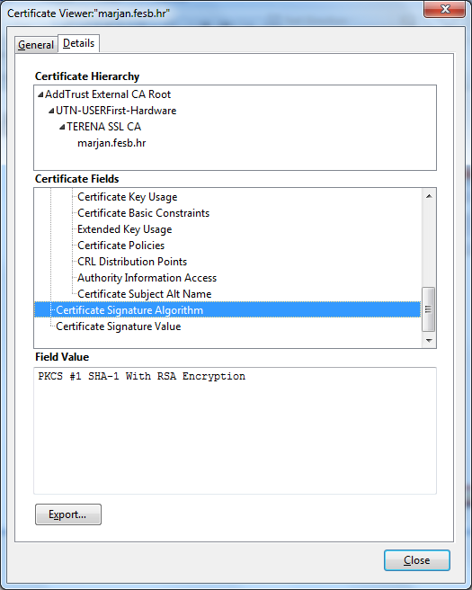
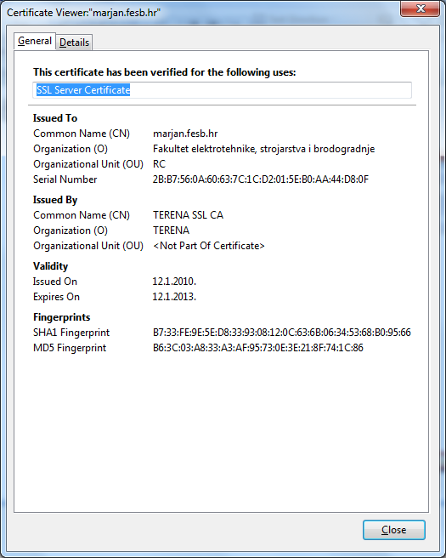
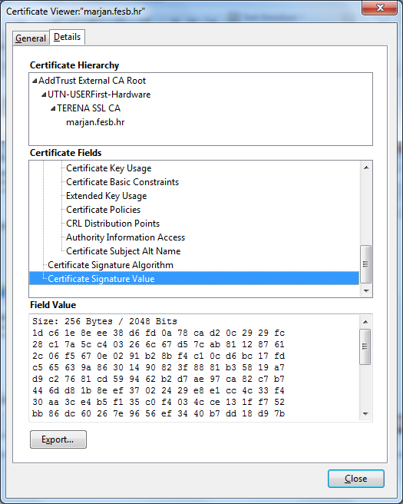
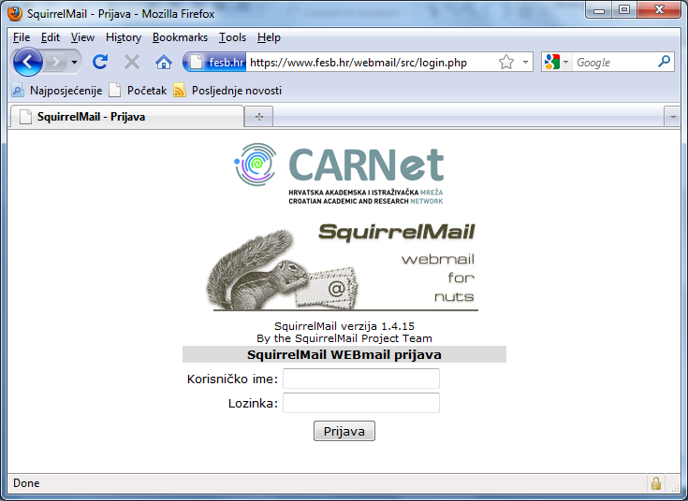
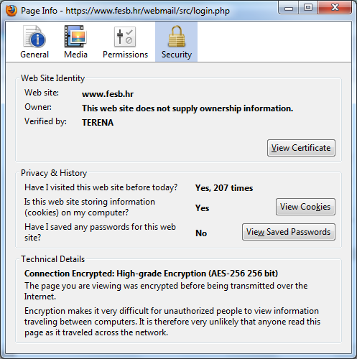
Public-Key Certificates: Examples

Slide 37
Digital Envelopes
Use of public-key encryption to distribute secret keys
Secret keys are more efficient and faster
B wishes to send a confidential message m to A
  A and B do not share any symmetric key
  B holds an authentic public key PU_{A} of A
  B prepares the message m and generates a one-time (session) symmetric key K
  B encrypts m: c_{m} = E[K,m]
  B encrypts the session key K using A’s PU_{A}: c_{K} = E[PU_{A},K]
  B forms a digital envelope Env = (c_{m},c_{K}) and sends it to A
  Only A is capable of decrypting the session key from c_{K} and therefore of recovering the original message m from c_{m}
Example: Windows© XP Encrypting File System (EFS)

Slide 38
Digital Envelopes
Symmetric encryption
m
c_{m}=E[K,m]
E
Encryption process (sender B)
PU_{A}
Public-key encryption
One-time symmetric key
K
E
c_{K}=E[PU_{A},K]
Symmetric decryption
m
D
Decryption process (recipient A)
Public-key decryption
PR_{A}
D
K

Slide 39
Random Numbers

Slide 40
Random Numbers
Play an important role in the use of encryption
Used in the generation of
  Keys used in both symmetric and public-key encryption
  Stream keys in a stream cipher
  Authentication protocols
  Secure tokens...
Requirements
  Randomness – based on statistical tests for uniform distribution and independence
  Unpredictability - successive values not related to previous (require some hardware generator, not always used)

Slide 41
Pseudorandom vs. Random Numbers
Often use algorithmic technique to create pseudorandom numbers
  Which satisfy statistical randomness tests
  But likely to be predictable
  E.g., encrypt a given random number n times with a secret key
True random number generators use a nondeterministic source
  E.g. radiation, gas discharge, leaky capacitors (natural processes and phenomenon)
  Increasingly provided on modern processors

Slide 42
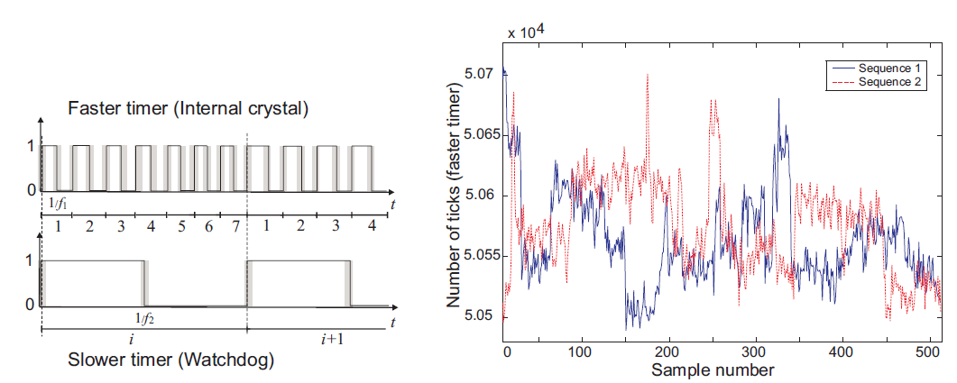
Example: Oscillator as a RNG
Frequency instability of an oscillator
Meshnetics ZigBee processors equipped with two usable oscillators, an Internal Calibrated RC Oscillator (4 MHz) and aWatchdog Oscillator (128 kHz).

Slide 43
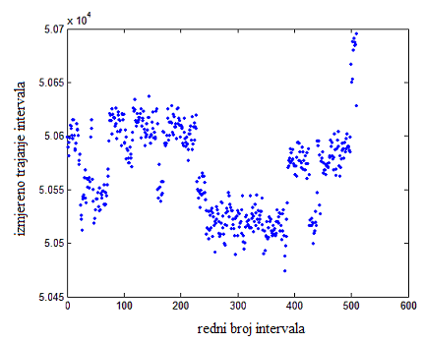
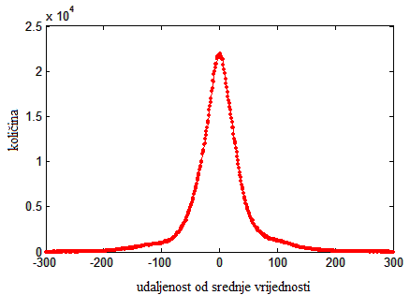
Example: Oscillator as a RNG
Random but not unpredictable
  Analysis of duration of individual intervals
Not unpredictable – neighboring intervals form groups
Distribucija odstupanja trajanja intervala od srednje vrijednosti
(good statistical properties – randomness)

Slide 44
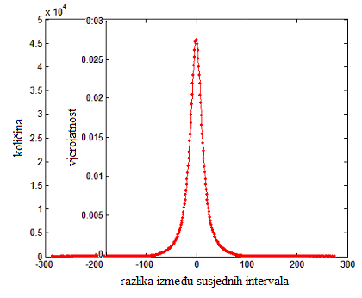
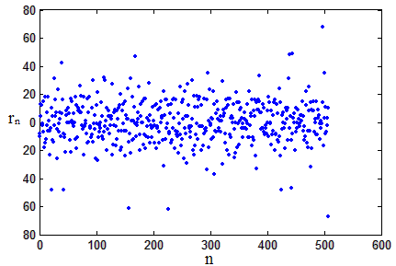
Example: Oscillator as a RNG
Can we improve by observing difference r between durations T of neighboring intervals (r_{n} = T_{n+1} - T_{n}, n=1,2,...)

Slide 45
Summary
Introduced cryptographic algorithms
Symmetric encryption algorithms for confidentiality
Message authentication & hash functions
Public-key encryption
Digital signatures and key management
Random numbers

